Slide 1
Basic Computer Skills
Windows & the Internet

Slide 2
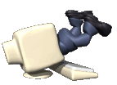
Introduction to Windows
Objectives:
  Identify and use computer hardware
  Open and close a desired program
  Switch back and forth between open windows
  Create and save a Word document on a floppy disc.

Slide 3
Introduction to Windows
What is a computer?
  A tool for accessing information.
  A PC is a personal computer – a one person or single user computer.
  A computer does not think on its own. You have to tell it what to do.
Basic computer parts:
  Computer case
  Monitor
  Keyboard
  Mouse

Slide 4
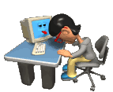

Introduction to Windows
Activity &
Review Questions

Slide 5
Introduction to Windows
The Desktop
  The desktop is the first thing you see when you log in- it is the “launch pad”
  Icons, or pictures, represent programs that are available on the computer.
  Notice the gray task bar at the bottom of the screen.

Slide 6
Introduction to Windows
Activity
  Locate the following items on your desktop:
      Taskbar
      Program icon
      Mouse pointer
      Start button

Slide 7
Introduction to Windows
Activity
  Starting a Program:
  You start, or open, a program by double-clicking its icon on the desktop
  The program is visible as a window on the computer screen
  A button representing the program appears on the taskbar

Slide 8
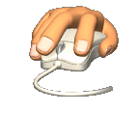
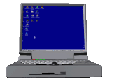
Introduction to Windows
Activity &
Review Questions

Slide 9
Introduction to Windows
Working With Windows
  A windows represents an open program or folder.
  You can have more than one window open at a time.
  The window you are working in is called the active window.
  The active window will be on top of any other open windows.

Slide 10
Introduction to Windows
Common Elements
  Common elements help make computers easier to use.
  Picture icons are used to represent actions.
  Most programs have things in common:
      Save
      Copy
      Paste
  Common elements look the same from program to program.

Slide 11
Introduction to Windows
Activity
  Some Common Elements to Locate:
    Title bar
    Minimize and Close buttons
    Scroll bar
    Insertion point
    Menu bar
    Microsoft Word button on the task bar

Slide 12
Introduction to Windows
The MS Office Menu Bar & Tool Bars
  All menu bars have these options:
    File
    Edit
    View
    Insert
    Tools
    Window
    Help

Slide 13


Introduction to Windows
Activity &
Review Questions

Slide 14
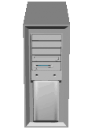
Introduction to Windows
Working with Files
  Create and save a document
  Opening files
  Create a folder

Slide 15
If you remember nothing else…
You can't harm a computer by experimenting or trying something new, so if you think you remember how to do something, try it. The worst that can happen is that you learn something new.

Slide 16

Introduction to the Internet
Objectives:
  Describe the function and components of the Internet.
  Use the Internet Explorer browser.
  Access Web pages
  Use Internet Explorer Help.
  Print a Web page.

Slide 17
Introduction to the Internet
What is the Internet?
  A worldwide network of computers
  Current information on almost any topic
  Communicate worldwide

Slide 18
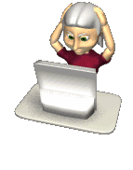

Introduction to the Internet
Activity &
Review Questions

Slide 19
Introduction to the Internet
Internet Explorer (IE)
  A Web browser used to navigate through pages on the Internet
  Web pages are accessed by hyperlinks or typed addresses
  A group of Web pages owned by one organization is a Web site
  The main page in a Web site is the home page

Slide 20
Introduction to the Internet
Navigating Internet Explorer
  The six main areas of IE are:
    Title bar
    Menu bar
    Toolbar
    Address bar
    Information bar
    Status bar

Slide 21
Introduction to the Internet
Navigating Internet Explorer
  The Toolbar buttons help you navigate:
    Back
    Forward
    Home
    Refresh
    Stop
    Search
    Favorites

Slide 22

Introduction to the Internet
Activity &
Review Questions

Slide 23
Introduction to the Internet
Internet Explorer Favorites
  Favorites are shortcuts to pre-selected Web sites.
  Access Favorites through the toolbar button
  Place a Web site in the Favorites folder

Slide 24
Introduction to the Internet
Internet Explorer Help
  Provides information, support, and tips for using IE
  Access Help through the menu bar
  Helpful topics include:
    Getting Started
    Taking the Tour
    Printing Information
    Saving Information

